Slide 1
Client Perspective Report
Syndemic
Alan Espinoza, Delena Turner, Jacob Herron

Slide 2

Introducing our Clients
Working for the CDC since 2017
Stationed to work with the Tennessee Department of Health in 2019
Diverse portfolio of experience including outbreak response, telemedicine implementation, public health social marketing, program evaluation, and community outreach
Amber Coyne

Slide 3
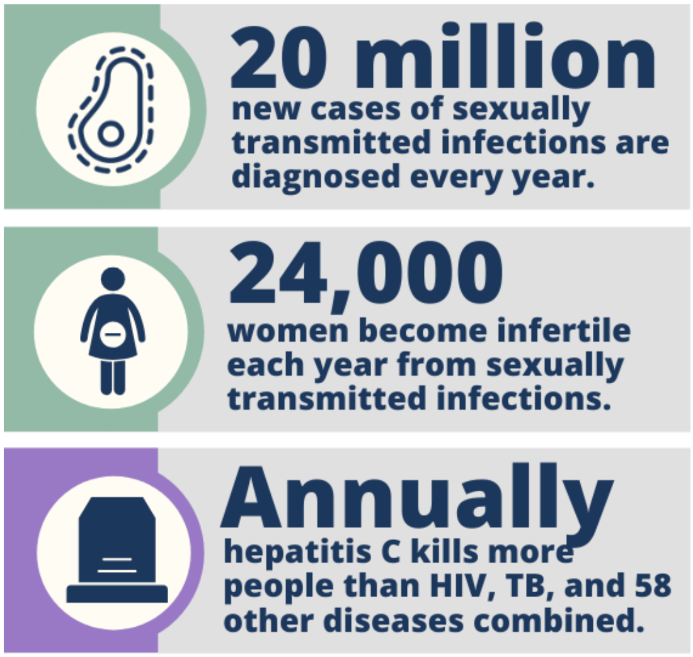
Problem:
A synergization of the HIV, STI, substance abuse, and viral hepatitis epidemics through shared needle use; our syndemic
A lack of public trust and understanding in syringe sharing programs despite proven effectiveness

Slide 4
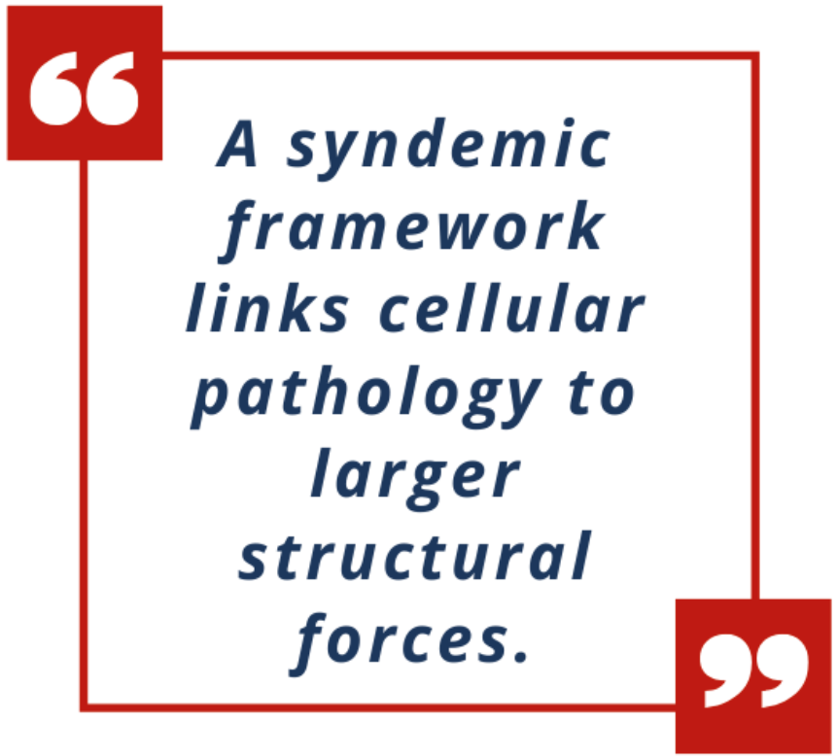
A Worldwide Impact
Hepatitis C has killed more Americans annually than HIV, tuberculosis, and 58 other reportable infectious diseases combined
Men who have sex with other men, transgender persons, young adults, and some racial and ethnic groups are disproportionately affected
Up to 70% of new hepatitis C infections are among people who inject drugs
Notes:
Approximately every 3 seconds someone dies indirectly to the Syndemic

Slide 5
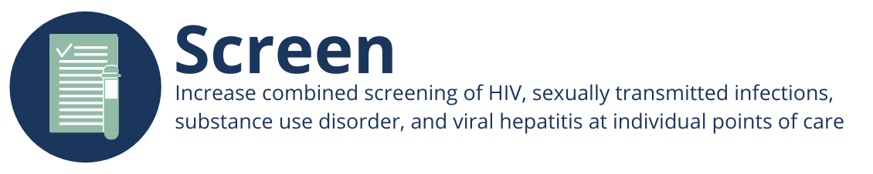
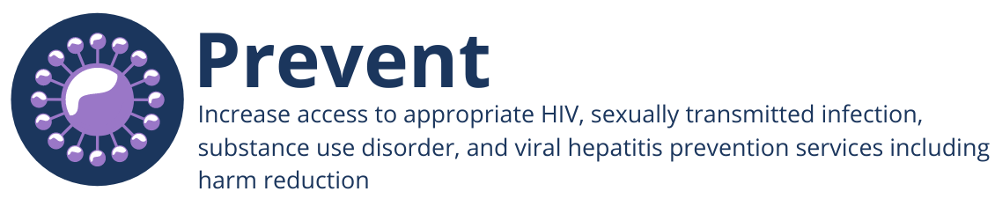

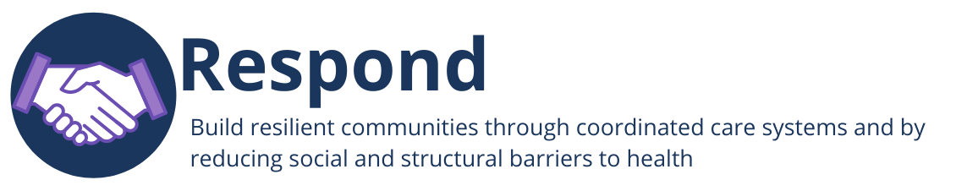
What are the End the Syndemic Tennessee goals?
Notes:
Talk about how these are the 4 main goals of End the Syndemic Tennessee! SCREENING meaning increasing screening of HIV’s, STI’s, SUD, and VH! Then PREVENTING the same four, then TREATING the same four, finally building relationships with the communities!

Slide 6
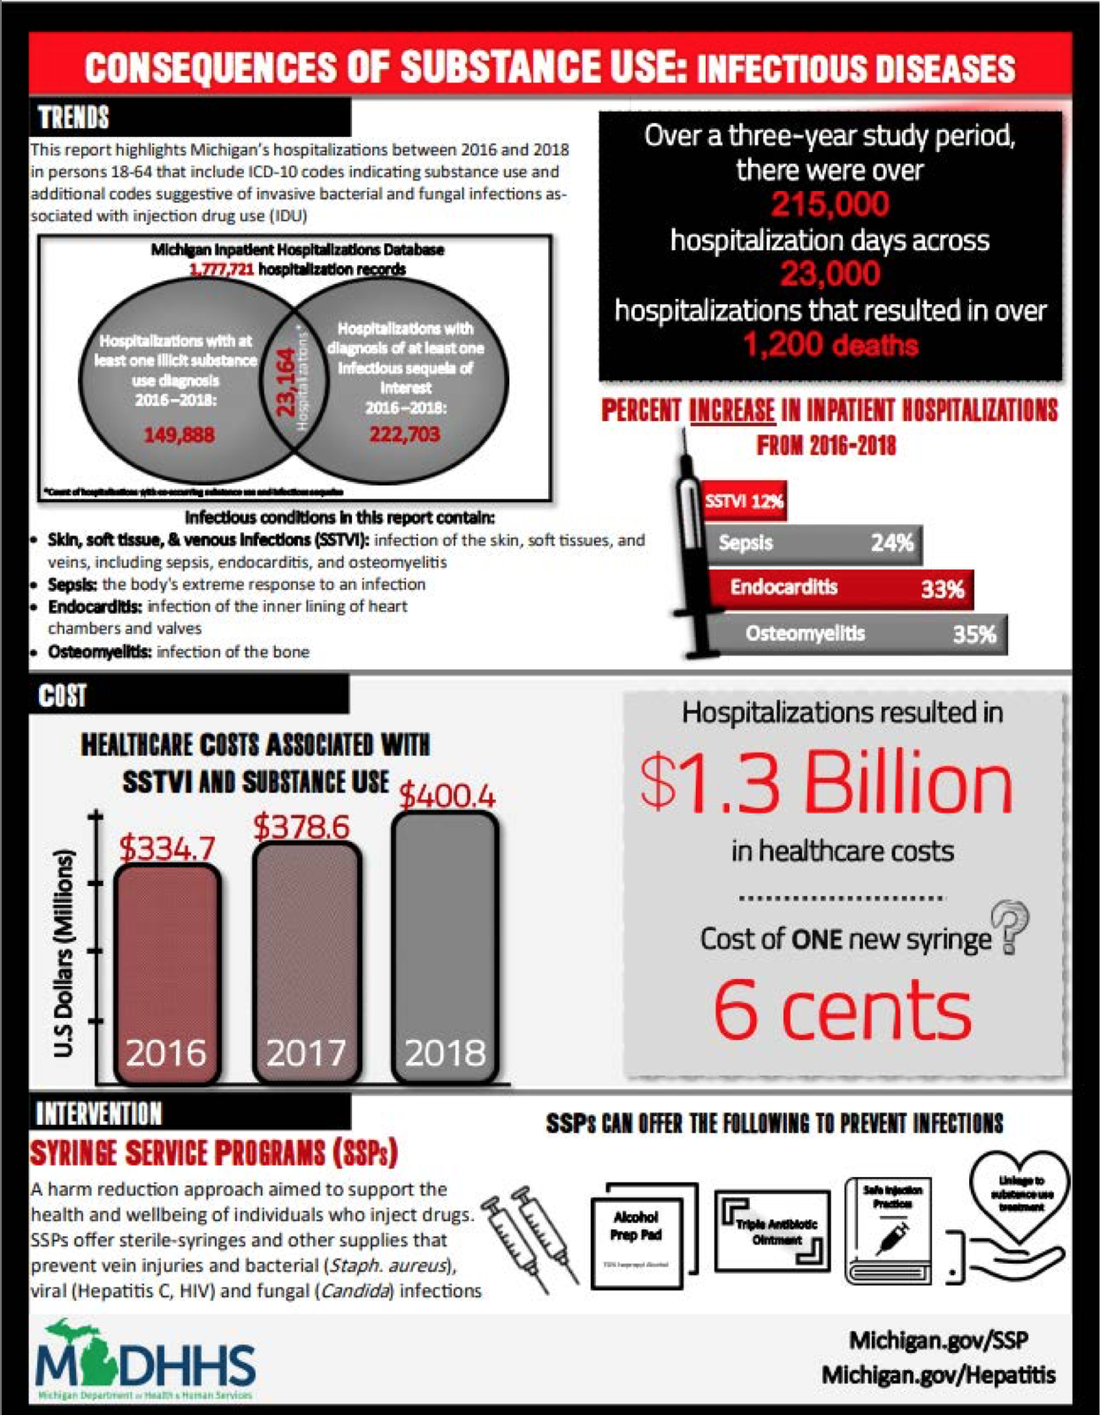
Our Mission
Our Predecessors: The Michigan Study
Bring awareness to the Syndemic and the Syringe Sharing Programs in Tennessee, which we currently have two of.
Analyze factors connected with the syndemic, including endocarditis, osteomyelitis, sepsis, and skin, soft tissue, venous infections (SSTVIs), along with information like the hospital's ICD-10 codes.

Slide 7
The Vision
Primary:
A simple, extensive, interactive dashboard which should include but not be limited to what assistance each local area is already providing, what areas are most in need, and how the endemic factors relate to age, race, sex, length of hospital stay, payer, discharge disposition, and cost.
Secondary:
Predictive models that allows researchers and lobbyists to strategically plan future policy
A one page summary of our work similar to the Michigan one pager
Notes:
Talk about the interactive dashboard, one pager, report we make, will be brought to End the Syndemic Tennessee Regional Planning Meetings where they will Present our data to help identify connections between the epidemics including biological vulnerability, behavioral vulnerability, and social determinants of health. Share evidence-based programs and emerging strategies to prevent and treat conditions within the syndemic. This would ultimately lead to creating strategies to helping and creating strong trustful relationships with the communities.

Slide 8

endthesyndemictn.org

Slide 9
TRANSITION HEADLINE
1
Let’s start with the first set of slides

Slide 10
Quotations are commonly printed as a means of inspiration and to invoke philosophical thoughts from the reader.

Slide 11
Partnership with DataLab
< / >
Problem: The prevalence of illnesses caused by sharing syringes
Mission: Analyzing data from the TN Dept. of Health to help alleviate the growing syndemic
Vision: We hope to raise awareness about the importance of syringe exchange clinics and assist in lobbying for their existence

Slide 12

MOBILE PROJECT
Show and explain your web, app or software projects using these gadget templates.

Slide 13

TABLET PROJECT
Show and explain your web, app or software projects using these gadget templates.

Slide 14

DESKTOP PROJECT
Show and explain your web, app or software projects using these gadget templates.

Slide 15
PRESENTATION DESIGN
This presentation uses the following typographies:
Titles: Catamaran Bold
Body copy: Catamaran Light
Download for free at: https://fonts.google.com/specimen/Catamaran
You don’t need to keep this slide in your presentation. It’s only here to serve you as a design guide if you need to create new slides or download the fonts to edit the presentation in PowerPoint®

Slide 16
TIMELINE
Blue is the colour of the clear sky and the deep sea
Red is the colour of danger and courage
Black is the color of ebony and of outer space
Yellow is the color of gold, butter and ripe lemons
White is the color of milk and fresh snow
Blue is the colour of the clear sky and the deep sea
JAN
FEB
MAR
APR
MAY
JUN
JUL
AUG
SEP
OCT
NOV
DEC
Yellow is the color of gold, butter and ripe lemons
White is the color of milk and fresh snow
Blue is the colour of the clear sky and the deep sea
Red is the colour of danger and courage
Black is the color of ebony and of outer space
Yellow is the color of gold, butter and ripe lemons

Slide 17
ROADMAP
Blue is the colour of the clear sky and the deep sea
Red is the colour of danger and courage
Black is the color of ebony and of outer space
1
3
5
2
4
6
Yellow is the color of gold, butter and ripe lemons
White is the color of milk and fresh snow
Blue is the colour of the clear sky and the deep sea

Slide 18
FUNNEL
AWARENESS
Insert your content
DISCOVERY
Insert your content
EVALUATION
Insert your content
INTENT
Insert your content
PURCHASE
Insert your content
LOYALTY
Insert your content

Slide 19
SlidesCarnival icons are editable shapes. This means that you can:
Resize them without losing quality.
Change fill color and opacity.
Change line color, width and style.
Isn’t that nice? :) Examples:
Find more icons at slidescarnival.com/extra-free-resources-icons-and-maps

Slide 20
DIAGRAMS AND INFOGRAPHICS

Slide 21
You can also use any emoji as an icon! And of course it resizes without losing quality.
How? Follow Google instructions https://twitter.com/googledocs/status/730087240156643328
✋👆👉👍👤👦👧👨👩👪💃🏃💑❤😂😉😋😒😭👶😸🐟🍒🍔💣📌📖🔨🎃🎈🎨🏈🏰🌏🔌🔑 and many more...

